Slide 1


INFOSYS SPRINGBOARD INTERNSHIP 6.0
Air Aware Smart Air Quality Prediction System
Presented By
R. Rajalakshmi
Batch – 7 (Python)
Team – 1

Slide 2
CONTENT
INTRODUCTION
PROBLEM DEFINITION
OBJECTIVES
PROPOSED SOLUTION
TECHNOLOGY STACK
PROJECT PREVIEW
RESULT & OUTCOMES

Slide 3
INTRODUCTION
Air pollution is one of India’s most critical environmental issues.
Cities like Delhi, Chennai, and Mumbai frequently record unsafe AQI levels.
People lack real-time, easy-to-understand air-quality insights.
AirAware provides a modern solution through monitoring, alerts, and visual analytics.

Slide 4
PROBLEM DEFINITION
No unified platform that shows real-time AQI + pollutant breakdown.
Existing tools are complex, lack trend analytics, or do not provide health guidance.
Users cannot make informed decisions about outdoor safety.
Need for a simple, accurate, intelligent air quality dashboard.

Slide 5
OBJECTIVES
To monitor real-time Air Quality Index (AQI).
To display pollutant levels (PM2.5, PM10, NO₂, SO₂, CO, O₃).
To visualize pollution trends using interactive charts.
To display weather parameters affecting AQI.
To provide alerts and health recommendations.

Slide 6
PROPOSED SOLUTION
A responsive, user-friendly dashboard for real-time AQI monitoring.
Backend APIs fetch pollution and weather data.
Trend charts for daily/hourly pollution changes.
Color-coded AQI categories with health messages.
Alerts when AQI crosses unsafe limits.
Downloadable PDF/CSV air-quality reports.

Slide 7
TECHNOLOGY STACK
Frontend
    React.js
    Tailwind CSS
Backend
    Python
    Node.js
Chart & Visualizations
    Line Chart
    Bar Chart
    Area Chart
    Radar Chart
    Pie Chart

Slide 8
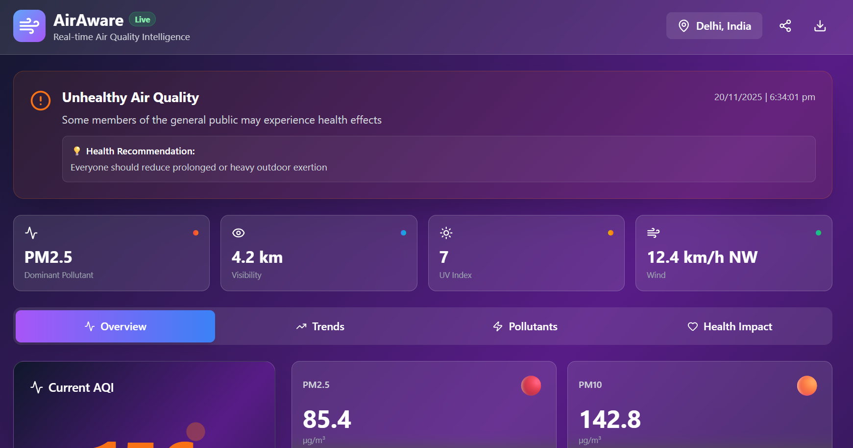
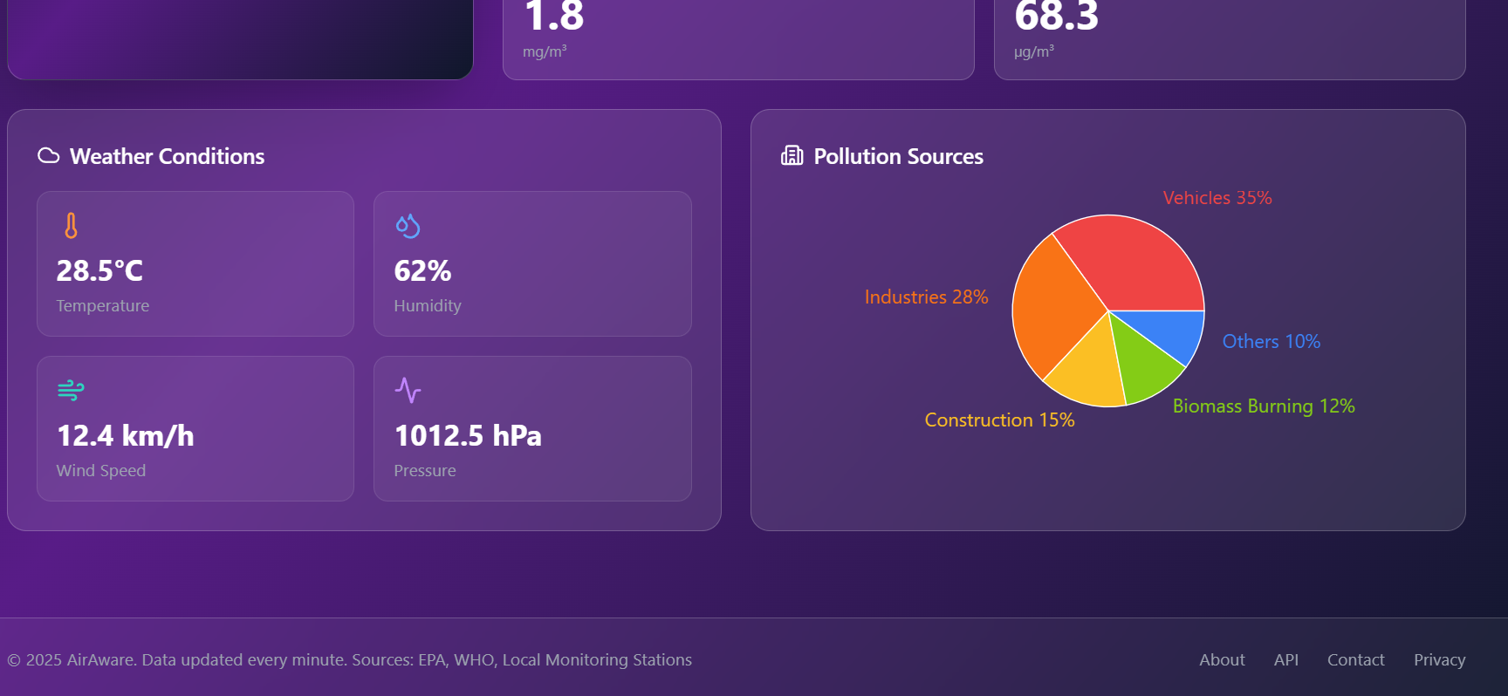
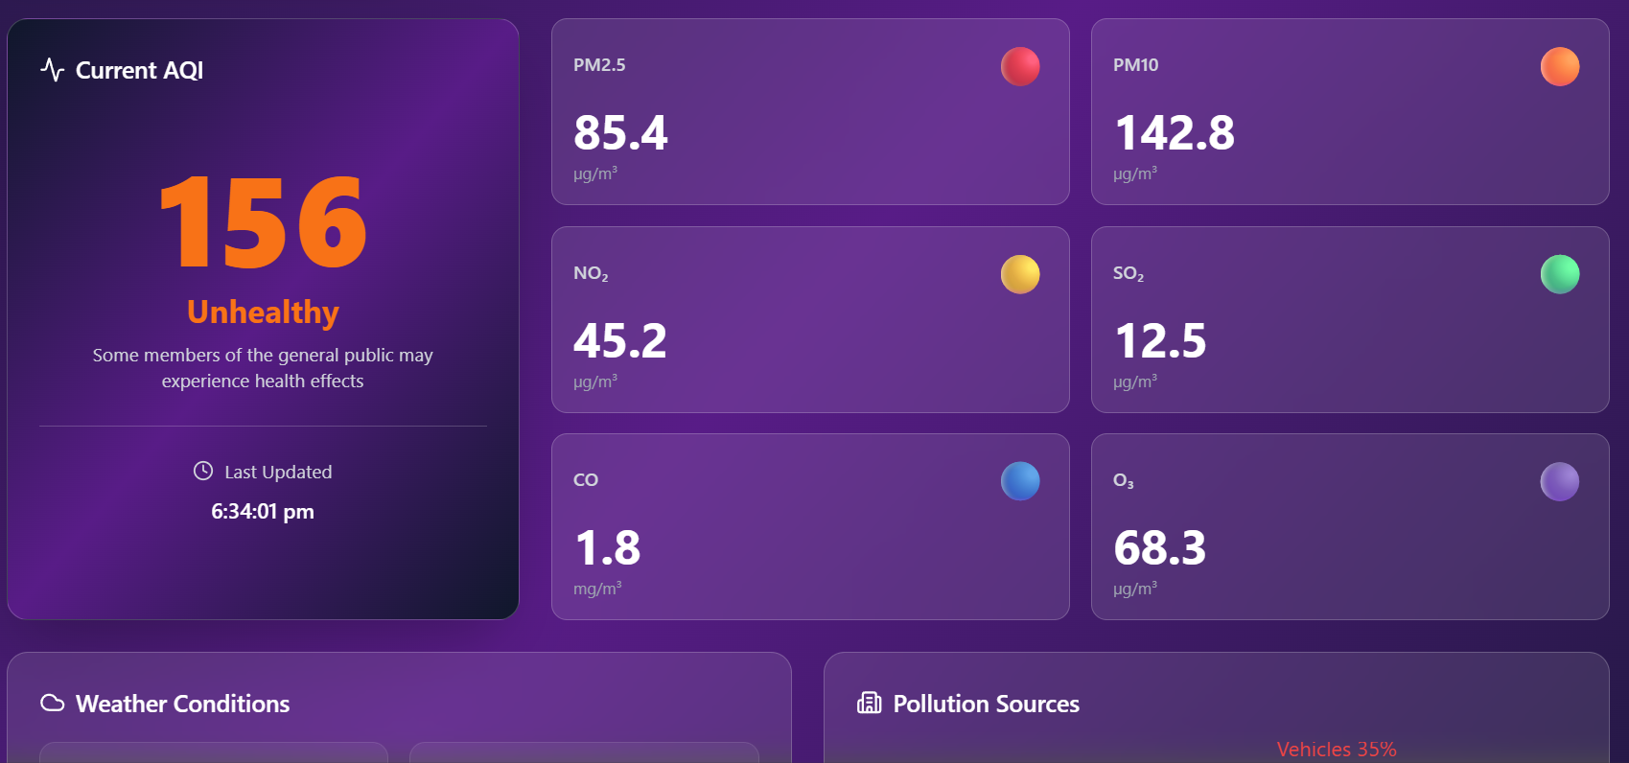
PROJECT REVIEW

Slide 9
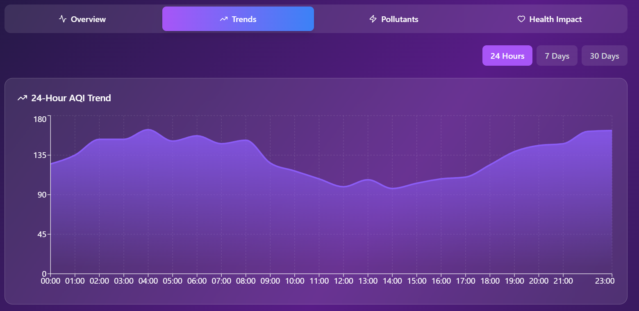
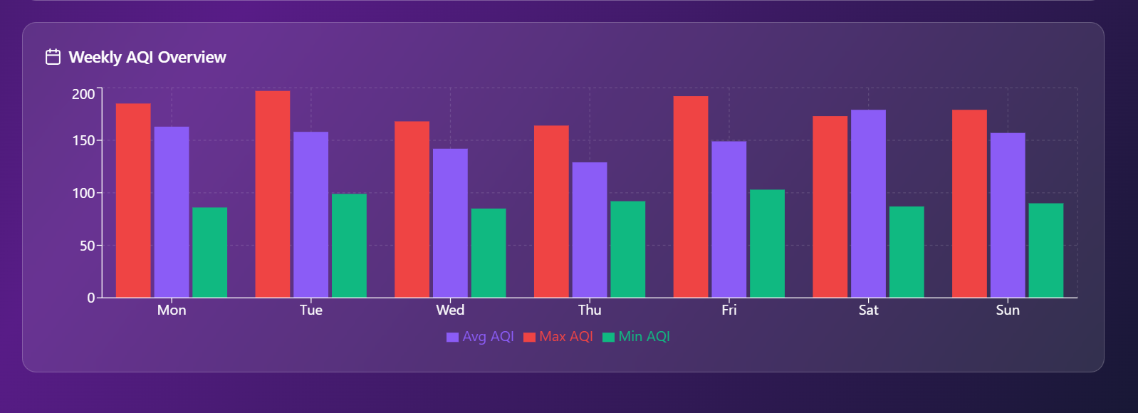
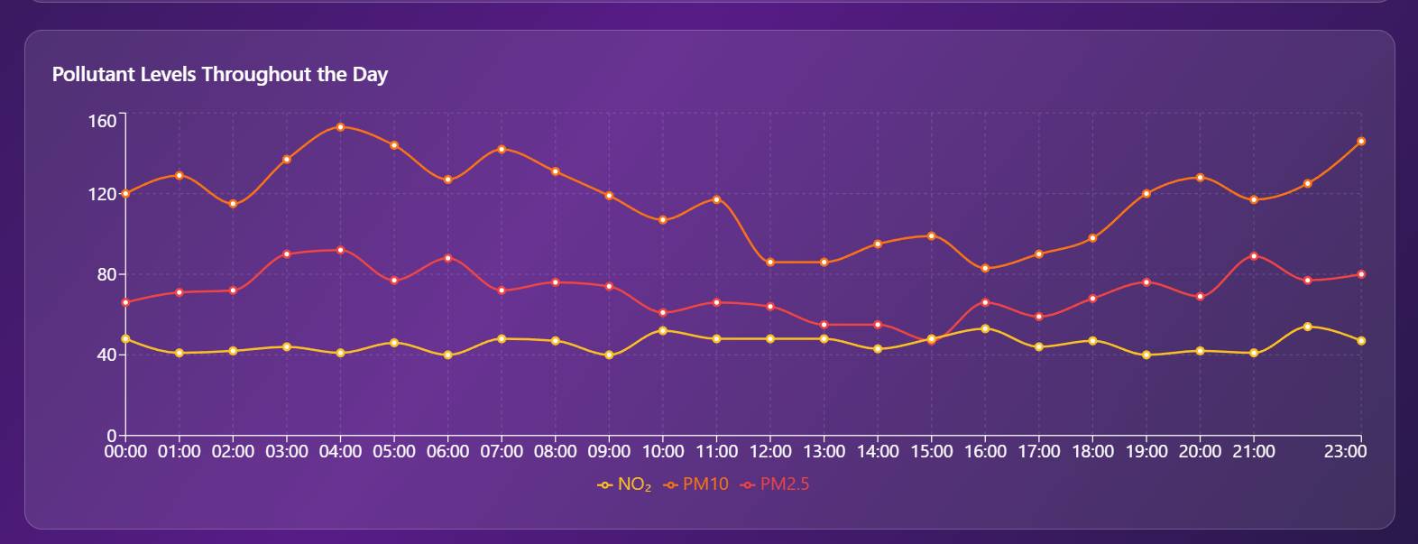
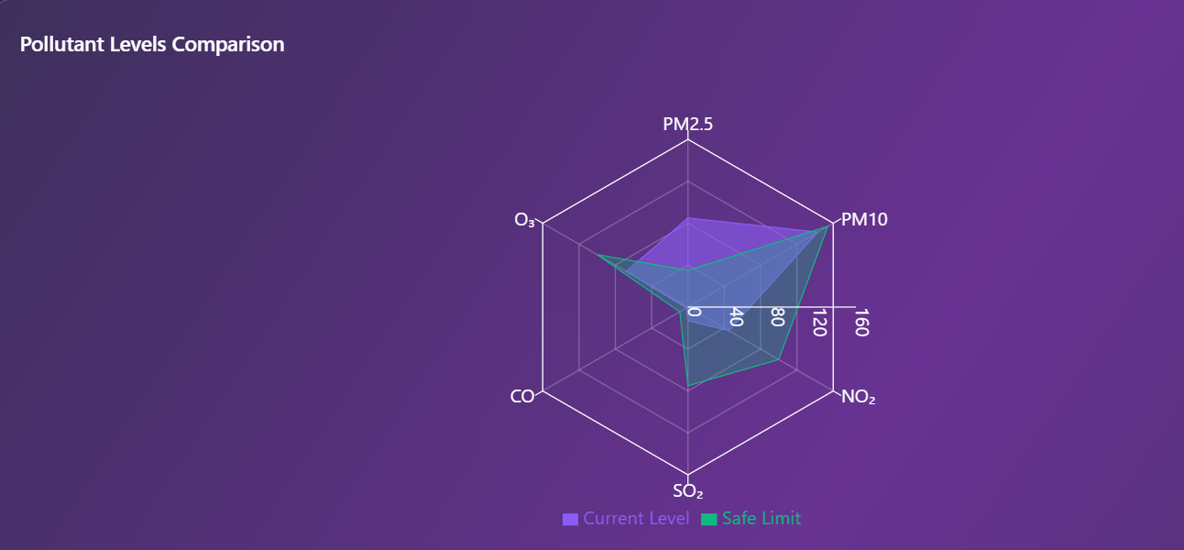
PROJECT REVIEW

Slide 10
RESULT & OUTCOMES
Users get real-time pollution insights.
Enables safer decisions about outdoor activities.
Helps students/researchers analyze air-quality trends.
Easy, modern dashboard improves public awareness.
Solves the need for transparent environmental data.

Slide 11
THANKYOU

